Slide 1
Plain English / Describing images using alt text
Sarah Fisher and Angela Groth-Seary

Slide 2
Session overview
Why plain English is vital for accessibility
How to write in plain English
Plain English toolkit
Alt text: what, when and how
Alt text exercise
Questions?

Slide 3
Plain English is…
‘a message, written with the reader in mind and with the right tone of voice, that is clear and concise.’ (Plain English Campaign)

Slide 4
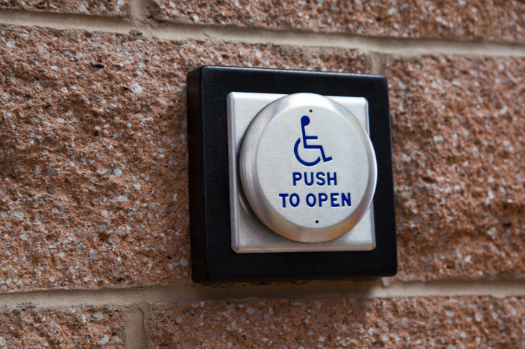
Why plain English is vital for accessibility

Slide 5
Plain English = accessible language
Writing in plain English makes communications ‘accessible to a greater number of people and may reduce demand for special accessible versions.’ (Government guidance on accessible communication formats)

Slide 6
10% of people are dyslexic
What that looks like: GitHub dyslexia simulator

Slide 7
A dyslexic Kent professor:
‘Then you realise it is in ZX281 rather than ZX182 and you’ve edited the wrong one. There goes an hour. A voice in your head is shouting “idiot” but you don’t believe in giving up in the face of adversity, so this goes on for another hour. The stress is causing the text to move and float around. You can no longer understand the words in the original email.’

Slide 8
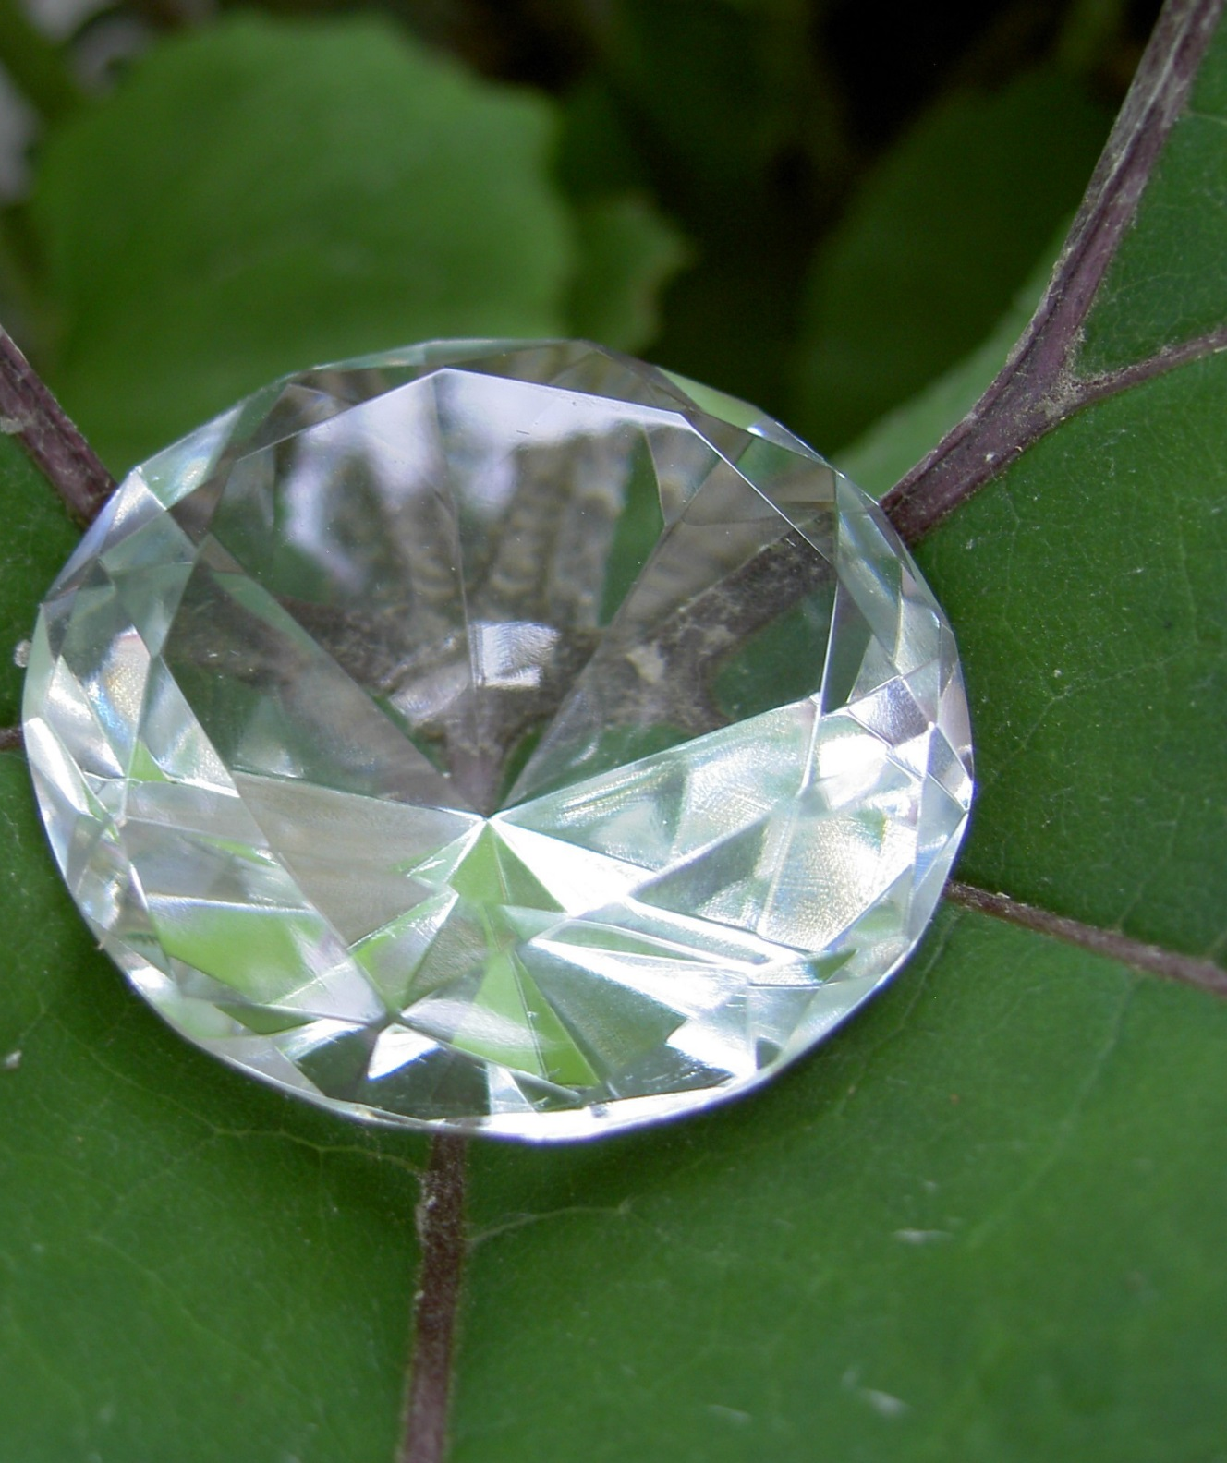
How to write in plain English

Slide 9
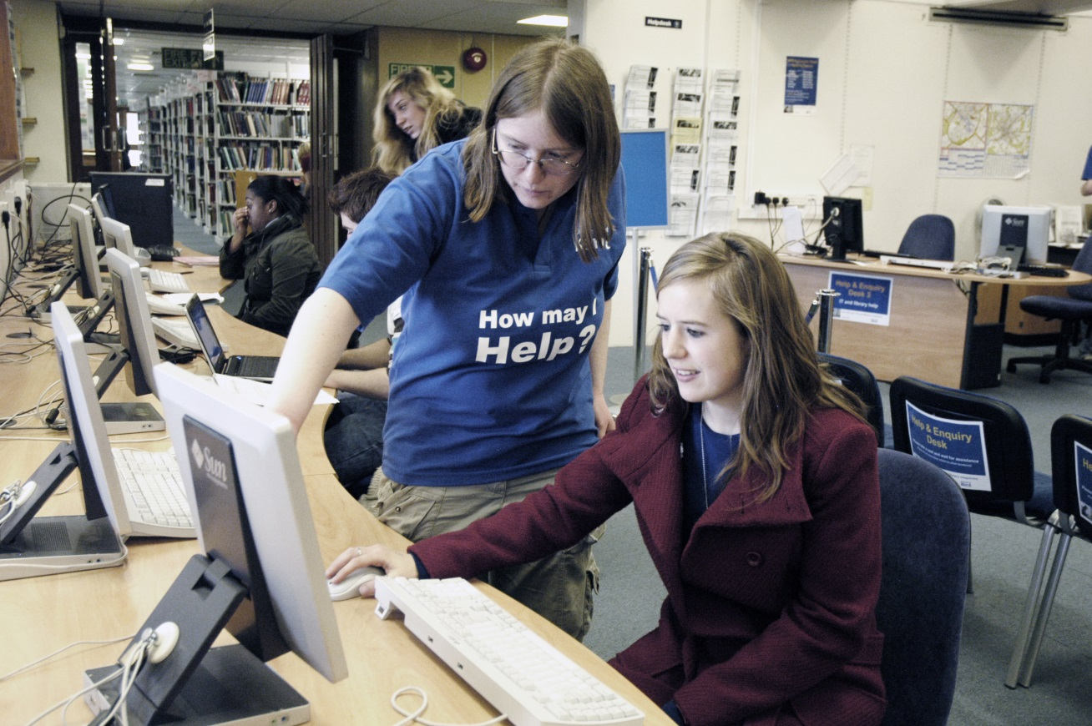
We and you
We – not Information Services, the University, the Council
You – not students, staff, the user, the applicant

Slide 10
We and you - example
Individuals are expected to ensure the personal computer and/or mobile device is in good order:
That they have the latest and all necessary critical security updates installed;
That they are using an appropriate anti-virus with up-to-date virus definitions (where appropriate);
That if they become infected with a virus or other malware infection, that they take appropriate action to disinfect their machine/device before its reconnection to the network.

Slide 11
Use active verbs
You can do this in StaffConnect not: This can be done in StaffConnect
Send your request to… not: Your request needs to be sent to…

Slide 12
Active verbs - example
Information Services are upgrading LibrarySearch but it will be impossible to migrate the Favourites data into the new LibrarySearch system.
This information will have to be saved before the 30th June so that you have a copy after the 1st July.
Notes:
We are upgrading LibrarySearch, but we won’t be able to migrate your Favourites into the new system. If you want to access them after 1 July, you’ll need to email them to yourself before 30 June.

Slide 13
Front-load your content

Slide 14
What does your reader care about most?
Say it first, in:
headings or subject lines
your document / email structure
paragraphs
sentences

Slide 15
Front-loading – example
Please be aware that due to planned electrical maintenance, the library will be closed from 06:00-12:00 on Saturday 9 April.

Slide 16
Keep it short and structured
Best average sentence length: 15-20 words
Cut out padding (and unnecessary politeness)
Keep paragraphs short and easy to scan
Use lists

Slide 17
Spot the padding
Please be aware that…
In order to…
Therefore it is recommended that…
The first priority…
Work collaboratively with…

Slide 18
How can we structure this?
It is recognised that Job shadowing can contribute to the development of an organisational culture that values depth and continuity of knowledge, encourages continuous learning, which is inclusive and welcomes diversity, promotes creativity and takes a positive approach to change.
(40 words)
Notes:
Job shadowing helps develop an organisational culture that:
* values depth and continuity of knowledge
* encourages continuous learning
* is inclusive and welcomes diversity
* promotes creativity
* is positive about change.

Slide 19
How about:
Job shadowing helps develop an organisational culture that:
values depth and continuity of knowledge
encourages continuous learning
is inclusive and welcomes diversity
promotes creativity
is positive about change. (28 words)
Notes:
Job shadowing helps develop an organisational culture that:
* values depth and continuity of knowledge
* encourages continuous learning
* is inclusive and welcomes diversity
* promotes creativity
* is positive about change.

Slide 20
Use the simplest words that work
Need – not: require, requirement
Tell – not: inform
About – not: in relation to
Buy – not: purchase
Fill in – not: complete
Help – not: assist, assistance
Extra, more – not: additional
If you ask – not: on request

Slide 21
Simple words – example
Please ensure you consult a medical professional prior to commencing a new dietary regimen.

Slide 22
Avoid nominalisations (zombie nouns)
They kill your meaning and eat your audience’s brains:
Beware nominalizations video (TED-Ed), by Helen Sword

Slide 23
Zombie nouns
They are nouns created from verbs, adjectives, or other nouns:
failure investigation
availability engagement
And sometimes words ending in –ing
Use strong verbs instead!

Slide 24
Plain English toolkit

Slide 25
1. Start with the audience
As a…
I want to…
so I can…

Slide 26
2. Self editing
“Kill your darlings, kill your darlings, even when it breaks your egocentric little scribbler's heart, kill your darlings.” – Stephen King
“If it is possible to cut a word out, always cut it out.” – George Orwell

Slide 27
3. Hemingway app
www.hemingwayapp.com

Slide 28
4. Pair writing
Team up with someone who doesn’t know the context of your communication.
Get them to ask you critical questions:
Who’s the target audience?
Is this the best angle?
Are the key points at the top?
What do you mean by this?
Is there a simpler way to say this?

Slide 29
Alt text: what, when and how

Slide 30
What is alt text?
A textual alternative to non-text elements in digital documents – for example images, graphs or diagrams – that can be read by screen readers.
It should be brief and relevant to the context.

Slide 31
When to add alt text
In any document that’s consumed digitally
If the image has essential information that someone who can’t see it would be missing out on
Not when it’s purely decorative
Context is everything!

Slide 32
How to write alt text
Context is everything! (We know we’re repeating ourselves…)
Every software should have a way to add alt text – look it up
Description, not title
Keep it short – ideally under 125 characters
Don’t include ‘image of,’ ‘picture of,’ etc

Slide 33
How to write alt text (2)
‘If you can close your eyes, have someone read the alt text to you, and imagine a reasonable accurate version of the image, then you’re on the right track.’
Advice from MOZ website

Slide 34
Let’s practice!

Slide 35
Tools for alt text
WebAIM alternative text article: https://webaim.org/techniques/alttext/
Interactive training tutorial: https://poet.diagramcenter.org/
Quick alternative text quiz: https://ccconlineed.instructure.com/courses/970/quizzes/10685/

Slide 36
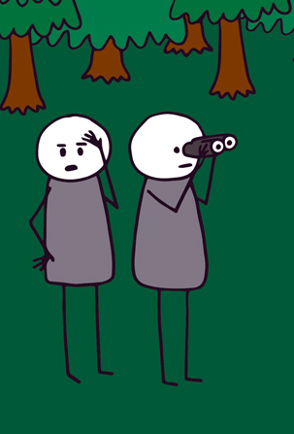
Contact us
Sarah: S.M.Fisher@kent.ac.uk
Angela: A.Groth-Seary@kent.ac.uk

Slide 37
Image credits:
Title slide: ‘Can’t see the wood for the trees?’ Bonny Colville-Hyde http://www.almostexact.com/ used with permission
Push button: slobo / Getty Images
Crystal: jdurham at https://morguefile.com/p/599042
Venn diagram: https://www.ned-potter.com/blog/where-to-start-when-planning-talk-or-teaching-session
Ernest Hemingway: public domain, Lloyd Arnold 1939
Golden retriever: https://www.pexels.com/photo/adult-golden-retriever-close-up-photo-752383/
Pancakes: https://theprettybee.com/basic-vegan-pancake-recipe/

Slide 38
Notes:
This

