Slide 1
Kent Digital Inclusion
Supporting the County to improve Digital Inclusion and Accessibility
Notes:
Today we have heard a lot about accessibility and digital inclusion, so by now you should all be familiar with why Accessibility is so important and what the big reasons are for why we are taking this seriously in Kent.
We have heard from the BDF about the sector wide situation and have heard what the regulatory body for new regulations has to say, thanks to GDS.
But now we would like to focus in on the scale of the challenges in Kent.
1min

Slide 2
Kent Stats
1.555 Million registered citizens
257,038 people (17.6% of the total population) in Kent considered themselves to have a health problem or disability which limited their day-to-day activities
3 Universities
19265 students at the University of Kent
14 Local Authorities
Numerous NHS organisations
Blue Lights Services
Figures taken from ONS Census information, KCC Disability in Kent report, and University admissions.
Notes:
But now we would like to focus in on the problem for Kent.
Kent has 1.555 million registered citizens
At the time of the 2011 Census 257,038 people (17.6% of the total population) in Kent considered themselves to have a health problem or disability which limited their day-to-day activities, lower than the national average of 17.9%
3 Universities
14 Local Authorities
A vast variety of NHS organisations
Several Blue Lights services including Police and Fire
Nearly all of our citizens will interact with some combination of these services throughout their life and many who interact with public sector services such as health or social care the most, are those who need our help the most. Government figures indicate that those who we would consider vulnerable and/or heavy users of public services have a high overlap with those who have a registered disability.
So What am I saying?
I am saying that we should absolutely ensure that those individuals who use and need our service the most and who are more likely to have access needs than any other, should be able to use any of our online services.
2 Mins (3)

Slide 3
Challenges
Compliance
Scale
Skills and Resources
Staff engagement and Culture Change
https://unsplash.com/photos/bJhT_8nbUA0
Notes:
What are the challenges to doing this?
Compliance
As we have heard there are new regulations and the existing equality act to be aware of. We have more obligations than ever to meet to ensure we are doing the best for our users, whether they be students, citizens, visitors to the area etc.
This is a double edged sword as it does mean we as organisations have more hoops to jump through but it also means that accessibility now has more weight behind it and can help us all better communicate the seriousness of this work to our leadership when asking for support.
Scale
As large organisations both Kent County Council and the University have vast web estates, not to mention all of the internal digital systems we use. Scale is a massive challenge under the new regulations.
With tight deadlines for ensuring our public facing websites are compliant and the lethargy and massive inertia that comes with progressing such a culture shifting piece of work in large organisations, we are hard pressed to meet these needs with the time and resources available.
Lack of Skill and resources
So how are we going to meet these new demands?
We will need skilled staff and to put resources behind ensuring our service are accessible.
Currently there is a serious lack both in our own staff and that of many suppliers we have seen in understanding the complexities of making services accessible.
To back this up even where there are the skills present, resource is often scarce where other subjects take priority or organisations cannot afford to free up staff to focus full time on accessibility.
Staff perception and involvement - culture change
Finally and to some extend a compounding of the problem just mentioned, we need to get all staff engaged. This isn't just an IT problem that developers must fix.
There needs to be a significant culture change across all organisations so that staff embed making services accessible as part of standard best practice. This means, beyond having competent developers to get services to an acceptable level of compliance, for us to maintain that high level of service we must spend time training staff, revamping processes that have up till this point encouraged accessibility to take a back seat and embedding this change into the organisation so that it lasts after the project ends.
3mins (5)

Slide 4
So what are we doing about it?

Slide 5
Cross Sector Partnership
Over the last 8 months Kent County Council on behalf of Kent Connects, and The University of Kent have been working together to build solutions to these new challenges.
Joined up approach
Sharing best practice
Consistent level of accessibility
Engagement with wider community
https://unsplash.com/photos/n95VMLxqM2I
Notes:
Through Kent Connects, which is a public sector technology partnership set up to help Kent Public sector organisations share best practice, run collaborative projects, improve services for citizens and reduce partner costs, we have started working closely with the University of Kent to look at how we tackle these challenges that are standing in the way of us delivering consistent accessible services across the county.
What we have been doing
Over the last 8 months Kent County Council on behalf of Kent Connects, and The University of Kent have been working together to build solutions to these new challenges.
Why?
Joined up approach – By working together we are developing a wider network of resource and expertise
Sharing best practice – We have learnt from each other by making use of the different focusses, experiences and backgrounds of our organisations. While KCC focussed on auditing and formalisation of those processes, the University has developed excellent methods of student support and content improvement.
Consistent level of accessibility – By aligning our approach and working towards a consistent level of accessibility we hope to create a better experience for all our users.
Engagement with wider community – The shared network of contacts across the partnership has enabled us to engage, learn from and contribute back to the wider community more than we could have individually.
Collective weight to decision making
Harnessing collective buying power and influence
1min (6)

Slide 6
What have we delivered so far?
This event is the culmination of our first steps in which we have:
Developed Accessibility Statements
Contributed to guidance now published by GDS nationally
Procurement information
Staff e-learning and guidance
Supplier engagement and guidance
Embedded into school of computing curriculum this year
Support for wider community
Notes:
So what has this partnership delivered so far?
Over the last 8 months we have worked on a number of key areas that we feel address immediate challenges and are also working to embed accessibility and inclusion as core values to help us continue to build and deliver better services in the long term.
30seconds (6:30)

Slide 7
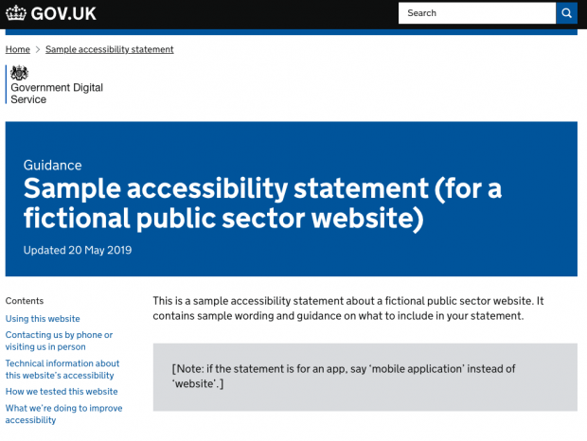
Accessibility Statements
Developed Accessibility Statements
Plain English
Legal
Known Issues
Contributed to guidance now published by GDS nationally
Notes:
Accessibility statements are a big part of the new regulations. The purpose of these statements is twofold, the first being in the same vein as cookie and privacy policies, we are making our legal declaration public to clarify what we are doing to meet our obligations. The second purpose is to provide important accessibility information to users and support them in better navigating our website.
For this reason we have chosen to focus on three distinct areas for our statements, the main section being a plain English description of what we are doing about accessibility on the website, advice on getting the most out of our site and how users can get in contact with us.
The second section is our legal declaration which meets the specific wording requirements, explaining how we are working towards and maintaining the compliance of our sites, and goes into more detail about our auditing process and how the complaints and enforcement procedures work.
The final section details our known issues, what we are doing about them and what workarounds and alternate channels are in place to support users while we are working on improvements.
We have had these statements checked by our Legal Officers, Digital Teams, and tested both by a network of fellow accessibility officers, and by real users to further refine the statement.
With all of the thought and effort that has gone into Kent’s combined work on accessibility statements, we wanted to share our learning further and so have been working with GDS to help shape their national guidance on accessibility statements. This guidance was released on the 20th May, and is a great starting point for organisations to cover off their obligations. There is a lot more guidance available that GDS have published to help with auditing and other topics about accessibility.
3mins (9:30)

Slide 8
Procurement Guidance
Services procured, commissioned or designed by the Supplier shall comply with:
(a) The World Wide Web Consortium (W3C) Web Accessibility Initiative (WAI) Web Content Accessibility Guidelines (WCAG) 2.1 Conformance Level AA;
(b) ISO/IEC 13066-1: 2011 Information Technology – Interoperability with assistive technology (AT) – Part 1: Requirements and recommendations for interoperability;
(c) The Equality Act 2010;
(d) The Public Sector Bodies (Websites and Mobile Applications) Accessibility Regulations 2018;
Notes:
One of the most immediate concerns was to stop the challenge of scale getting any bigger.
To do this it was clear that we had to make changes to the way in which we all procure digital services.
To that extent both KCC and The University have embedded these requirements into the procurement process for future digital services, thus ensuring that not only will future public facing website be accessible but that all future digital service whether internal or external, have appropriate accessibility features to support all of our users, including our own staff.
The points that we have asked suppliers to demonstrate conformance with are:
WCAG 2.1 AA
ISO 13066, interoperability standards
The Equality Act
The Public Sector Bodies Accessibility Regulations
1:30min (11:00)

Slide 9
Procurement - Model Answer
Yes, ****** complies with The World Wide Web Consortium (W3C) Web Accessibility Initiative (WAI) Web Content Accessibility Guidelines (WCAG) 2.1 Conformance Level AA. An accessible and pleasant experience to all users, regardless of disability, is a key focus of ******. The ****** platform was built using the most modern HTML and CSS technologies, and is committed to W3C's Web Accessibility Initiative and Section 508 guidelines.
As well as accessibility testing the system ****** also provide an in system accessibility tester, link here ********.
All our course content is created and tested with accessibility first. We test on multiple browsers and run accessibility tests on all our courses as part of our technical testing. ******is built to be accessible.
Notes:
Do we want to include the Model Answer that the university received recently in a tender?
This could help people see what they should be expecting from suppliers as an appropriate response.
Obviously this is what we feel is appropriate but for further information on what we should request from suppliers, please speak to GDS.
2mins (13)

Slide 10
Staff e-learning and guidance
Productivity Tools – www.kent.ac.uk/tools
Accessible Video Guidance
Writing for the Web and Plain English support
3rd party content
Understanding the regulations
Notes:
As we identified earlier, one of the big challenges is engagement with staff, training and culture change.
What good is putting in all this work to make our platforms compliant in a technical sense if the moment one of our staff uploads a new piece of content all of our hard work is undone?
Staff training on the actions they need to take when creating content, and how their actions affect users is vital to helping us deliver accessible content and services.
We have started building out a library of guidance for our staff to help them meet their responsibilities and have been supporting this with direct engagement and face to face training sessions.
Productivity Tools
Accessible Video
One of the most common questions we get is about video content and this was clearly something we needed to address early, so KCC’s Digital team have delivered guidance for making video’s accessible.
Writing for the web and Plain English
Both the University and KCC have resources and support available for staff to help them improve their writing for the web and how to cut out a lot of jargon. We have two of our Plain English experts running workshops as part of the afternoon sessions.
3rd party content
Another common discussion point is the exact responsibilities when it comes to different types of 3rd party content. This conversation is still evolving as more and more scenarios are thought of, but we are continuing to update our 3rd party content guidance with the latest information as it comes.
Understanding the Regulations and Auditing process
Finally we have been putting on both face to face training sessions and delivering e-learning and other resources to help staff understand what the new regulations mean for us all, our existing obligations under the equality act and how we assess accessibility.
3mins (16)

Slide 11
Working with Suppliers
Websites are not always managed by us
How to we get suppliers to help us make services accessible?
Contract requirements
Convince them of the benefits
Buying power
Wide range of supplier reactions
Developing accessibility skills in suppliers
Supplier handbook
Notes:
We don’t always manage all of our websites and often 3rd party suppliers are brought in to deliver a specific product and help us maintain it.
With these new regulations we have had to thoroughly examine all of our existing services and agreements with our suppliers.
To achieve the levels of compliance that we need to, we absolutely need the help of our suppliers to make the improvements required.
Sometimes this might be easy if accessibility requirements are already in the contract, sometimes it is not so clear cut.
We have already seen the entire spectrum of responses from suppliers when our requests come through.
We have been told categorically they are not going to do the work
We have has suppliers jump at the chance to work with us on this
And we have had everything in between.
Dealing with these situations needs to be done amicably and with both our requirements, and the constraints of the suppliers in mind.
One of the challenges we identified earlier is a lack of skill, many suppliers we have spoken to are not familiar with the technical intricacies required to deliver the changes we request and as such this is one of the main points of contention. This is why we have been building a supplier handbook to help any developers we work with understand our requirements, and direct to a host of resources available for them to better understand what this translates into from a technical sense.
A final point on working with suppliers is that this should be seen as an opportunity to gain a market advantage. As we are only procuring accessible services from now on, we are on the lookout for conscientious suppliers who understand our accessibility requirements. I am sure as time goes on this is going to be the case across the sectors. Suppliers who engage now, work with us and grow their own skills are giving themselves an advantage in future tenders, framework applications, and also improving their reputation. (many of our proactive suppliers are already taking the opportunity to promote their accessibility knowledge as an additional selling point.)
3mins (19)

Slide 12
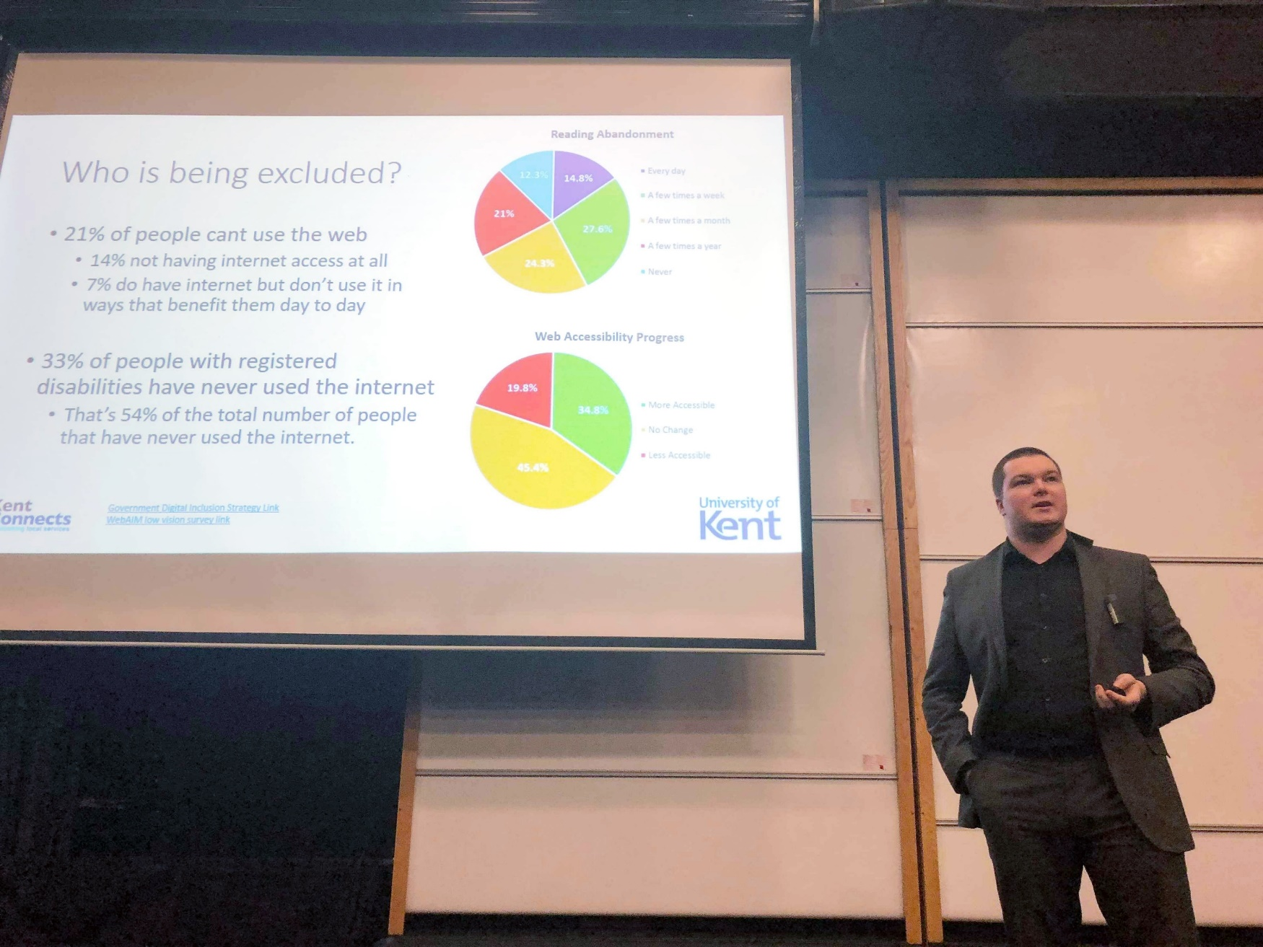
Embedding in Curriculums
Embedded into University of Kent school of computing curriculum this year
1st Year People and Computing
3rd Year Internet of Things
3rd Year Kent IT Consultancy
Assessments
Notes:
Through our partnership and with strong connections to the School of Computing at the University of Kent, we have also achieved something that I feel very passionately is the first step on a very important journey.
This year we have had the opportunity to provide content into the School of Computing Curriculum in a number of areas.
Accessibility has been included into the 1st Year’s People and Computing module which focuses on teaching students about design concepts, and how their work as service designers has an impact on the end user. This is a fantastic place to start the conversation about accessibility. We lectured at both the Canterbury and Medway campus and had great feedback after the lectures about the content. To further embed the learning, accessibility made up part of the assessments for the module.
Accessibility considerations were also further embedded into one of the 3rd Year Internet of things assessments which looked at the more technical aspects as the assessment had a significant focus on a web front end deliverable.
It is fantastic that we have had the opportunity to include this, and I should say a massive thank you to the School of Computing for supporting us in the message and seeing the value in teaching this to students.
And for us it is very valuable to start introducing students to accessibility at this stage. These are going to be the next web developers, project managers, and service leads. They are the next generation of digital skills in Kent, and so we should be working closely with the Universities to help direct the students to learn skills that the market needs. It is beneficial for us as employers in the long run that we are clear on what skills we are looking for and help to foster their growth locally. Its beneficial for the University and students to know that they are learning skills that are in demand and getting industry guidance through our collaboration.
2mins (21)

Slide 13
Wider Community Engagement
FHEDAWG
Leadership
Resource sharing
BCS
UKAAF / RNIB
AbilityNet
NHS
https://unsplash.com/photos/vpxeE7s-my4
Notes:
We know that everyone is looking for guidance when it comes to accessibility at the moment, how full this room is, is testament to the interest accessibility is creating.
Through the partnership we have become very engaged in the wider community. This is more than just an opportunity for us to go to a few conferences and a free lunch. There is real value in seeking out other interested individuals in this field, and we have seen many results develop out of this wider engagement.
FHEDAWG
The Further and Higher Education Digital Accessibility Working Group
Kent are a leading figure in this community
Mailing list
Sub groups
Actionable outcomes
British Computing Society
The BCS are taking Accessibility very seriously and we have already heard from Howard today who chairs the BCS disability specialists group. Kent have been involved in supporting BCS events and sharing back our experiences to local authorities through this engagement. Many who we have spoken with at these events are here today, and I hope this will help us create better relationships with our regional neighbours going forward.
UKAAF / RNIB
Next week we will be speaking at the AGM for the RNIB about the work Kent has been doing for accessibility.
AbilityNet
We have been invited to deliver webinars for AbilityNet on our approach to accessibility statements in July.
NHS
Through Howard and others we are starting conversations with NHS organisations across the county as part of the Health and Social care joint work. We are looking at how we can support digital inclusion in the patient care process.
Now all of this sounds like we are very fond of our own voices. Considering how long this presentation has been I wouldn’t blame you for thinking that. But we have more than just applause to gain from this. KCC is a signatory to the Local Digital Declaration, and a large part of the responsibilities under that declaration is to share best practice and experiences when signatories do something innovative. We feel that what has been achieved here in Kent can be a great example to others, and we should be ready to support others in learning from our successes and failures. There is no reason not to help other organisations become accessible. At the end of the day, it all leads to us collectively delivering better and more accessible services to all.
2mins (23)

Slide 14
Next Steps
We are going to be publishing all of our resources for procurement, auditing, training etc. for all of our Kent Connects and University of Kent Partners to use
We are going to continue to engage with the wider community and for all those in the room who aren’t a signed up Partner we are still going to be making many of our materials available along with engaging in training and support opportunities
https://unsplash.com/photos/bt-Sc22W-BE
Notes:
2min (25)

Slide 15
Contact Us
George Rhodes
Digital Accessibility Compliance Lead
Kent County Council
George.Rhodes@kent.gov.uk
Ben Watson
Accessibility Information Advisor
University of Kent
Opera@kent.ac.uk
Notes:
30 seconds

