Slide 1
Accessibility and Service Design
Considering accessibility concerns when designing products and software
George Rhodes

Slide 2
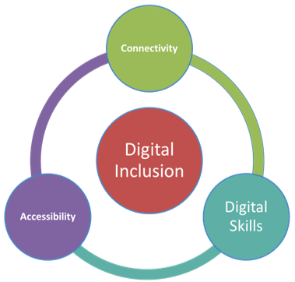
What is Digital Inclusion & Accessibility?
“Digital inclusion means allowing anyone to make use of the internet, a computer or digital tools regardless of ability.”
Making products accessible to people means taking into consideration things like screen readers, keyboard only users, and disabilities that may affect how someone uses your product.
Notes:
What is Digital Inclusion?
Digital Inclusion means allowing anyone to make use of the internet, a computer, or digital tools regardless of ability.
This is a statement from the Governments Digital Inclusion Strategy. In effect this means that no matter who you are or what abilities you have, you should be able to make use of the internet, digital services, etc. to benefit you.
This is a really important point that the Government is getting behind and it is easy to see why.
Since 2002 government services have been moving more and more online. Most councils want to completely reduce the number of face to face interactions and calls they take for cost reasons. Its expensive to run call centres and have staff on hand to sit and discuss on a one to one basis when you can make all services available on a website. This however hits us with the problem of what do you do for people who cannot use the internet? This is what the Government wants to tackle so that all citizens can use their service regardless of ability.
There are three pillars to digital inclusion. These are:
Connectivity – Providing access to digital services through diverse channels.
Digital Skills – Giving users the support / ability to use computers and the internet.
Accessibility – Services should be designed to meet all users’ needs, including those dependent on assistive technologies.
Now Accessibility is the point we are going to go into more details on as this is the one that is most relevant to your field, as it takes into account things such as software engineering, web development and content creation.

Slide 3
“The main thing that makes inaccessible web content frustrating for me is when I am looking for headings or links on the website, but the headings and links were not marked as such, so the screen reader does not find them. As a consequence I have to press tab at least a thousand times to find the paragraph or link I want. The same goes for text on a website that is not marked or defined as text, so that I can’t jump to the relevant sections with my screen reader. It would be better to not have as many hyperlinks in a long text, because every time there is such a link the screen reader says: “link” or “hyperlink” which makes reading an text more difficult sometimes. It would be better if the links were placed at the end of the paragraph like: “To view more click here”. This is then no problem at all.
I think that a clear structured website does not only assist users of screen readers, but all people who want to use the website and find the relevant issues quickly.”
Stage 1 law student with a visual impairment
University of Kent
Notes:
This is a statement from a student from the University of Kent. I think this helps to bring home the message that this is a real issue that affects real people.

Slide 4
Why is this important?
Scale of exclusion
Legal Incentives
New Regulations
Equalities Act
Wider Audience
Better Reputation
Leads to better services overall
decorative image source
Notes:
There are a number of points that we are going to run through as to why all of this is more important now than ever.
The scale of the problem
The legal incentives that are making this something that has to be done
The chance to widen the audience your services can be consumed by
The chance to be early on the bandwagon and build a reputation
And the multiple examples of where adopting an accessible first approach is actually delivering better services for everyone.

Slide 5
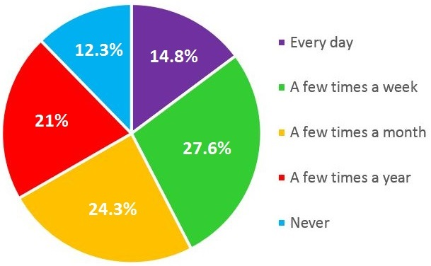
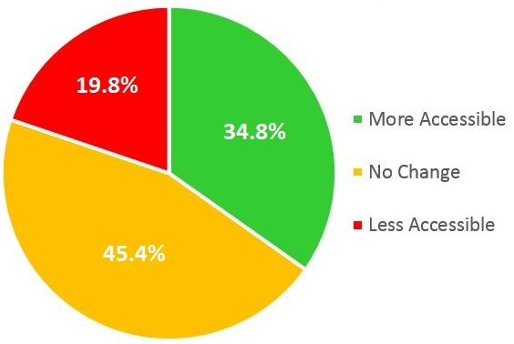
Who is being excluded?
Reading Abandonment
21% of people cant use the web
14% not having internet access at all
7% do have internet but don’t use it in ways that benefit them day to day
33% of people with registered disabilities have never used the internet
That’s 54% of the total number of people that have never used the internet.
Web Accessibility Progress
Government Digital Inclusion Strategy Link
WebAIM low vision survey link
Notes:
The BCC figures identify 21% of people who cant use the web. 14% having no access at all, and the other 7% having access but not using it to benefit them day to day.
Digital exclusion affects some of the most vulnerable and disadvantaged groups in society, including those in social housing, those on lower wages or unemployed, older people, and those with disabilities.
How many of you here have a grandparent who struggles to use the internet? Or would prefer to go down to the bank in town rather than use online banking.
Think about how much more effort this brings to the user when they want to accomplish something that otherwise could take a few minutes online.
Now lets focus back in on disabilities. 33% of people with disabilities have never used the internet and is 54% of the total number of people to have never used the internet. Those numbers add together to make approximately 1 in 13 people in this category.
I’m sure you have all heard stories of people who learn to play diablo through complex mechanisms that they control with their tongue or other such stories. These are held as miraculous stories of someone overcoming a debilitating disability. But our perspective as service provides means we need to look at this as the amount of effort it can take for someone with a disability to overcome obstacles and complete simple actions online.
WebAIM surveyed visually impaired people in September 2018 and released figures that help outline the scale of the problem.
It shows that 66.6% often (a few times a month or more frequently) abandon reading web content because it is not accessible. 14% abandoning web content every day. To make their experience even worse 45.4% of those questioned feel that accessibility is not getting any better, and 19.8% feel it is getting worse.

Slide 6
Legal Incentives
Equalities Act 2010
Public Sector Bodies (Websites and Mobile Applications) (2.0) Accessibility Regulations 2018
decorative image source
Notes:
There are now two pieces of legislation that govern commitments towards the accessibility of digital content.
The first and longest standing is the Equalities Act 2010. This act binds all to making reasonable adjustments for users who require additional assistance in using your product or service. At the end of the day, this is the regulations that is all comes down to. Under the equalities act if you (as an organisation / business etc.) are found to be in breach of the law you can be fined “unlimited damages”.
The Equalities act has always been there and everyone should already be at a position where accessibility is considered in whatever you are building. However we don’t live in a perfect world and this is not the case.
This leads us onto the second piece of legislation, the Public Sector Bodies (Websites and Mobile Applications) Accessibility Regulations 2018.
This new legislation that came into force in September 2018 now adds further requirements to all Public Sector Bodies to ensure that their digital content is accessible. This affects all Councils, Blue Lights Services, NHS organisations, Universities, Rail Organisations, Other Public Transport, Schools, Utility providers and more. Basically if you provide a vital service to the public you will come under this new regulation.

Slide 7
Public Sector Bodies (Websites and Mobile Applications) Accessibility Regulations 2018
Adherence to Web Content Accessibility Guidelines 2.1 AA standards
Accessibility Statements and commitment to accessible content
Financial and Reputational Penalties if you don’t meet requirements
Notes:
So what does this new regulation mean.
It means that all organisations affected now have a legal obligation to meet national standards of best practice by adhering to the Web Content Accessibility Guidelines (WCAG) 2.1 to a AA standard.
Government Digital Service (GDS) on behalf of the Minister of the Cabinet Office are the monitoring body for the Regulations, checking accessibility compliance. The Equality and Human Rights Commission are the enforcement body and will be looking at non-compliance in the same was as a failure to make reasonable adjustments. This can incur significant penalties if enforced.
GDS have outlined a timeline that identifies key deliverable dates under the new legislation.
GDS can ask an organisation at any point for evidence of internal process and work towards compliance. If non-compliance is identified, GDS can escalate enforcement as well as the compliance issues being published to the public; this can result in exposure to secondary challenges under the existing Equality Act (2010), carrying a penalty of unlimited damages.
The entire user journey, including backend systems, is considered under the legislation. As a result, an organisation which hosts, funds or contributes to any digital interface will be liable under the legislation.
The new regulations are a useful mechanism for organisations to improve the services they provide. By considering and auctioning proper accessibility practices, organisations inherently improve the user experience of a platform, resulting in an increase of engagement and view time on digital content.
Although the private sector does not have to comply with the regulation, suppliers will be required to ensure that their platforms are compliant in order to be procured by public sector organisations; this should result in an industry-wide move towards accessibility compliance and most importantly, improving the overall user experience of digital content for all audiences.

Slide 8
Widening Audiences and Improving Reputation
Accessible content can help attract more and repeat business
Easier to use services make everyone’s life easier
Being inclusive can have a reputational impact
Customer perception
Employability
Brand recognition
Notes:
Other benefits of accessible design include widening your audience and improving reputation
Engage that additional 7% of people who currently don’t use products because of digital exclusion
Might be missing out on customers because they cant use your product
If customers have a good experience they will come back
Making services easy to use don’t just affect those suffering from digital exclusion. All your customers will benefit from well though out and easy to understand services.
Reputational benefits
Customer perception can improve from good experiences, not only will they come back as mentioned but will tell others about the good service
Question: Who cares about what a company’s ethos is before they work there?
Company ethos is often very important to you when looking for employment, a company’s message and reputation affects how many people want to join their business.
As a professional, your added skills knowledge and conscientiousness can set you apart from others and provide you with a greater reputation for quality work

Slide 9
Better Services
Netflix
Microsoft
Easy Read
Alternate methods for consumption
Notes:
Examples of how services have improved because of accessibility concerns.
Netflix subtitles – who watches with subtitles on?
That was originally an accessibility thin, now everyone uses it, when on the train, when in a loud environment, or just to better catch what characters are saying.
Microsoft – design ideas, outlook improvements
Have met with their head of accessibility. And they have walked us through their plans to further improve the accessibility of all Microsoft products
Easy read models
Anyone ever gotten fed up with over complicated content? Easy read versions not only help those with learning difficulties, but can provide a quick and easily digestible version of content that can make life easier for all users.
Alternate methods for consumption.
Will get onto some of what the university has to offer shortly, but have you thought about alternate content types? Originally an accessibility feature for those that could not consume video, audio or text content for one reason or another. Now allows you to take in info the way you want. Want to listen to an article or a book, get an audio version (audible great example of how popular that is), want a written version of a recorded interview, or lecture talk so that you can highlight important parts, make notes? Consider a transcript.

Slide 10
What you should consider
Accessibility in web content and platforms
Software engineering
Real world user testing
Professional ethics
Notes:
I've spoken a lot about that Accessibility and digital inclusion means for businesses and government but lets now focus on how you can incorporate some of this thinking into your work.
As mentioned there are new regulations coming in around web content and platforms. As many of you may be budding web developers this is an area you should look to develop on when growing your skills. Think about what the purpose of the website is, are you considering alternate routes for those who cant use your main design?
And what about the design? When you are trying out something new and flashy, picking themes etc. check to see if they support accessibility plugins. When creating web forms, consider what default text might be read out to support users in understanding what needs to go in a box.
Web content, Think about the images you use, why have pictures of text when you could just have text? Remember if you are using images to consider adding alt text descriptions. What about videos or other media content you plan to embed on a website. Can people get to those correctly?
For those of you more interested in software engineering, think about your user interfaces, are things laid out clearly? Have you got a suitable amount of contrast between text and background? Who is your product for? A company? End Users? If you are developing products to sell, consider the legal and other obligations that companies buy products under. For instance now Government should not be buying and software systems that are not accessibly designed.
Think about real world user testing. Just because your product makes sense to you, have you gotten some friends, or members of your target audience to have a look through? Have you got them to try and complete tasks using your product? Can they do it? Have you tried working through it with just a keyboard? How about with a screen reader?
You should also consider what kind of professional you want to be. This comes up way more in the 3rd year Computing Law and Professional Responsibility module, but its good to think about. Where do you draw the line at your contribution to a working system for everyone. Would you be happy as a professional to have your name associated with products that excluded people, or were the cause of an equalities act case?

Slide 11
How this can help you going forwards
Accessible considerations make a difference to everyone and often feed into better services overall
Developing best practice and professional responsibility
Developing in-demand skill set
Notes:
So with those things to keep in mind when you are creating things in the future lets look at why this can be a positive for you.
First, as mentioned, accessibility can often lead to better products and services for everyone. If you are taking accessibility into consideration when testing, and building, what else might you discover that actually makes life easier for all of your users?
Developing your skills so you meet industry standards and best practice can only be a benefit when you graduate. Building up that knowledge base and skill set can help set you apart from other applicants. It’s a next level of understanding of the considerations you need to have when creating products that can demonstrate to employers that you are the right candidate. Same thing goes for many other areas. A good understanding of data protection, cyber security or any other specialism can help you in that respect. They all demonstrate a deeper level of understanding.

Slide 12
University Support
Accessibility – Student Support
www.kent.ac.uk/accessibility
Productivity Tools
www.kent.ac.uk/tools
OPERA (Opportunity, Productivity, Engagement, Reducing barriers, Achievement)
https://www.kent.ac.uk/studentsupport/accessibility/opera.html
VLE accessibility
Notes:
Within the university you already have lots of support for the accessibility of students.
If you want to find out more or make use of the support and tools available to you please take a look at some of these links.
The OPERA team have put in a lot of work to support you learning in ways that suit you.
Some of the tools available can dramatically change material to suit you, including conversion into different formats, including audio transcripts of documents. Very useful for those who may wish to listen through longer pieces of content.

Slide 13
Further Resources
GDS website - https://gds.blog.gov.uk/
Legislation - http://www.legislation.gov.uk/uksi/2018/852/contents/made
Accessibility Statements - https://gds.blog.gov.uk/2018/11/21/public-sector-website-accessibility-statements-what-you-need-to-know/
Government Digital Inclusion Strategy - https://www.gov.uk/government/publications/government-digital-inclusion-strategy/government-digital-inclusion-strategy
WCAG 2.1 AA - https://www.w3.org/TR/WCAG21/
WebAIM - https://webaim.org/

Slide 14
Any Questions?
Want to get in touch?
Enquire@kentconnects.gov.uk

