Slide 1
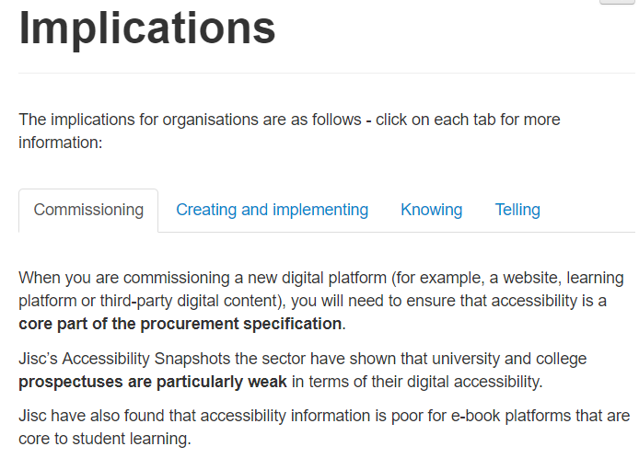
The driver
Web Accessibility legislation
The Public Sector Bodies (Websites and Mobile Applications) (No. 2) Accessibility Regulations 2018
https://www.legislation.gov.uk/uksi/2018/952/made
Notes:
EU Web Accessibility Directive
The Public Sector Bodies (Websites and Mobile Applications) (No. 2) Accessibility Regulations 2018
https://www.legislation.gov.uk/uksi/2018/952/made

Slide 2
Application
‘New’ websites (created on/after 23 Sept 2018)
Need to be compliant by 22 Sept 2019.
Any other “pre existing” websites
Need to be compliant after 22 Sept 2020
Extranets/intranets (VLEs) published before 23rd Sept 2019 are exempt until they ‘undergo substantial revision’ (4.2.g)
Notes:
Application
‘Newish’ websites (created on/after 23 Sept 2018)
Need to be compliant by 22 Sept 2019.
Any other websites
Need to be compliant after 22 Sept 2020
Extranets/intranets (VLEs) published before 23rd Sept 2019 are exempt until they ‘undergo substantial revision’ (4.2.g)

Slide 3
What is a website?
Website
Content collections with specific exemptions
Heritage collections
Web pages
Intranet / Extranets
Archives
Design
Interactive controls
Informative content
Informative content types with specific exemptions (some time limited)
Style sheets defining design elements
Site-wide components
Reusable components
Web page specific content consumed by users
Documents
Colours
Navigation menus
Forms
Text, headings, lists
Time-based media
Font style
Search box
Buttons
Images, icons, time-based media
Online maps
Font size
Footer
Accordions
Links, labels & accessible names
Some 3rd party content
Diagram permission of Dr Abi James CC-BY-SA

Slide 4
Timing is everything - websites
P = when published
Grace period
Website
Office files
Pre recorded time based media
Compliance
P
P
P
P
Sept 2018
P
P
Sept 2019
Active admin
Not active admin
P
Active admin
Not active admin
All content
Sept 2020
P
Diagram created by Alistair McNaught on ‘good faith’ basis. It does not constitute legal advice.
CC-BY-SA
All content
‘New’ website
Old website
‘New’ website
Old website
Any
Notes:
Diagram created by Alistair McNaught on ‘good faith’ basis. It does not constitute legal advice.
Websites
Image has timeline from top to bottom with key dates (Sept 2018/Sept 2019 / Sept 2020)
Across the top are columns representing different assets – website, office files and prerecorded media.
The timings for the relevant grace periods and compliance periods are identified (with their timings) for new websites (since Sept 2018) and old websites (pre 2018)

Slide 5
Timing is everything – Extranet/intranet
P = when published
Office files
Pre recorded time based media
VLE
(interface / content)
Grace period
Compliance
P
Sept 2018
P
P
P
P
P
Sept 2019
P
Not active admin
Active admin
Revised?
All content
Sept 2020
P
Diagram created by Alistair McNaught on ‘good faith’ basis. It does not constitute legal advice.
CC-BY-SA
‘New’ VLE
Old VLE
‘New’ VLE
Content of extranets and intranets published before 23rd September 2019, exempt until such websites undergo a substantial revision
Notes:
Diagram created by Alistair McNaught on ‘good faith’ basis. It does not constitute legal advice.
Extranet / Intranet / VLEs
Image has timeline from top to bottom with key dates (Sept 2018/Sept 2019 / Sept 2020)
Across the top are columns representing different assets – VLE interface, office files and prerecorded media.
The timings for the relevant grace periods and compliance periods are identified (with their timings) for new VLE (since Sept 2018), old VLEs (pre 2018) and their office file and time based media content.

Slide 6
Example: Documents on external websites
Publication date | Website | Accessibility requirement applies
Document published after 23 Sept 2018 | “New” Website | 23 Sept 2019
Document published after 23 Sept 2018 | Existing website | 23 Sept 2020
Document published before 23 Sept 2018 but still in active use | "New" Website | 23 Sept 2019
Document published before 23 Sept 2018 but still in active use | Existing website | 23 Sept 2020
Document published before 23 Sept 2018 but not in active use | "New" or existing website | Exempt
"New" website = External website published or updated after 23rd Sept 2018
Existing website = website has not been substantially updated since 23 Sept 2018

Slide 7
Example: Documents on intranet
Publication date | Intranet | Accessibility requirement applies
Document published after 23 Sept 2018 | "New" intranet | 23 Sept 2019
Document published between 23 Sept 2018 and 22 Sept 2019 | Existing intranet | Exempt until and unless the host Intranet/extranet is updated some time after 23 September 2019
Document published after 23 Sept 2019 | Existing intranet | Exempt until and the host Intranet/extranet is updated some time after 23 September 2019
Document published before 23 Sept 2018 but still in active use | "New" intranet | 23 Sept 2019
Document published before 23 Sept 2018 but still in active use | Existing intranet | Exempt until and unless the host Intranet/extranet is updated some time after 23 September 2019
Document published before 23 Sept 2018 but not in active use | "New" or existing intranet | Exempt
"New" intranet = intranet published or substantially revised after 23rd Sept 2018
Existing intranet = intranet has not been substantially revised since 23 Sept 2018

Slide 8
Example: Videos
Publication date | Website | Accessibility requirement applies
Live Videos | Any site | Exempt
Live video stored on a website for more than 14 days after the recording, published after 23 Sept 2020 | Any site | 23 Sept 2020
Pre-recorded video published before 23 Sept 2020 | Any site | Exempt
Pre-recorded video published after 23 Sept 2020 | Any site | 23 Sept 2020
"New" website = External website published or updated after 23rd Sept 2018
Existing website = website has not been substantially updated since 23 Sept 2018

Slide 9
Example: Informative content (e.g. a blog)
Publication date | Intranet | Accessibility requirement applies
Content published after 23 Sept 2018 | "New" external website | 23 Sept 2019
Content published before 23 Sept 2018 but still in active use | "New" external website | 23 Sept 2019
Content published after 23 Sept 2018 or published earlier and still in active use | Existing external website | 23 Sept 2020
Content published before 23 Sept 2018 but not in active use | Existing external website | 23 Sept 2020 unless website qualifies as an archive
Content published after 23 Sept 2019 | "New" intranet | 23 Sept 2019
Content published before 23 Sept 2019 | "New" intranet | 23 Sept 2019
Content published after 23 Sept 2019 | Existing intranet | Exempt until intranet undergoes substantial revision
Content published before 23 Sept 2019 | Existing intranet | Exempt until intranet undergoes substantial revision
"New" intranet = intranet published or substantially revised after 23rd Sept 2018
Existing intranet = intranet has not been substantially revised since 23 Sept 2018

